Slide 1


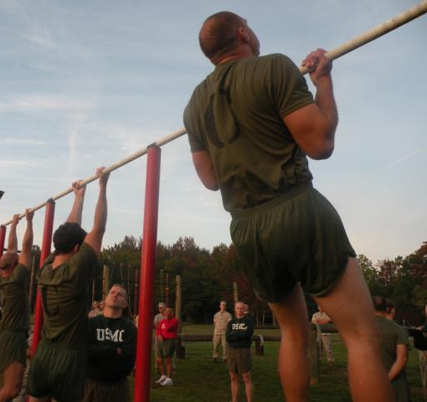

Effects of Linear Periodization Training on Performance Gains and Injury Prevention in a Garrisoned Military Unit
Study Population
Background
Method
Outcome
Implementing fitness training policies is not standardized across US military branches and units. This contributes to lower performance and higher injury rates.
Service members participated in an 11-week strength and conditioning program that increased load and repetitions over time.
80% completed program
From pre- to post-training:
Cardiorespiratory fitness
Upper-body strength
Core strength
Injury rate
*1.3 injuries/100 person-months
Could a conditioning program based on linear periodization address this gap?
A standardized linear periodization training program is feasible and demonstrated improvements in fitness with low injury rates.
C. Heard, M. Wilcox, M. Falvo, M. Blatt, D. Helmer J Mil Veterans Health. Jul. 2020.

