Slide 1

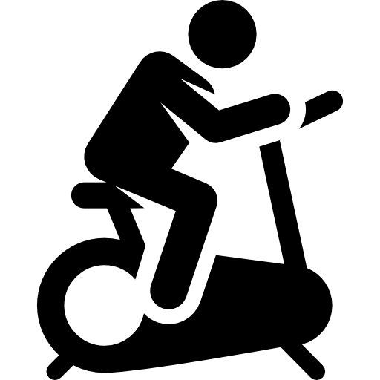


Post-Exertional Malaise in Veterans with Gulf War Illness?
Study Population
Gulf War Illness is a chronic, multi-symptom illness that affects between 175,000 to 250,000 American Gulf War Veterans.
Lethargy
Dizziness
Do Veterans with Gulf War Illness experience greater PEM following exercise than Veterans without?
Gulf War Illness
Rashes
Mood, pain and gulf war illness symptoms were measured pre-, post-, and 24-hours post exercise.
Headache
Irritable Bowel
Chronic Pain
GWI
Veterans
Non- GWI
Veterans
Post-Exertional Malaise (PEM)
∙Pain
∙Fatigue
∙Cognitive issues, etc.
after physical or mental exertion.
Not all GWI Veterans have significant worsening of symptoms
Acute exercise does not worsen symptoms for the majority of Gulf War Veterans with Gulf War Illness
Lindheimer et al. Int J of Psychophysiol. Jan. 2020.

