Slide 1

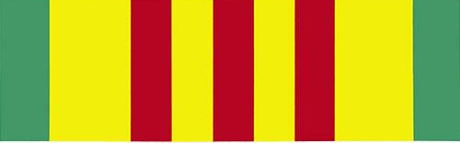
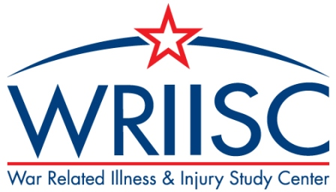
Impact of Presumed Service-Connected Diagnosis on VA Healthcare Utilization of Vietnam-Theater Veterans with service-connected disabilities
Study Population
Background
Objective
Outcome
In the past, Vietnam veterans had difficulty proving that certain medical conditions were related to Agent Orange exposure during deployment.
Healthcare utilization-Vietnam veterans
In response, VA presumes certain medical conditions to be service connected in an effort to allow veterans easier access to VA services.
Are Vietnam veterans with presumptive conditions more likely to use VA healthcare than those without?
Controlling for other factors, Vietnam veterans with diagnosed presumptive conditions were more likely to use VA healthcare.
Presumptions may be a critical regulatory mechanism for increasing VA healthcare access.
Fried et al. Medicine. May 2018.

